Slide 1
Data Structure and Algorithm
Course Code: CS-201
Topic: Doubly link list

Slide 2
Goals for today
To study:
Linkedlist
Doubly/ Two-way linked list

Slide 3
CLO Covered
CLO1: Explain the fundamentals of data structure as well as algorithms that operate on them
CLO2: Apply and design various data structures methods for specified applications.

Slide 4
Two-Way List
What we have discussed till now is a one-way list [ Only one way we can traversed the list]
In a single linked list, every node has a link to its next node in the sequence.
So, we can traverse from one node to another node only in one direction and we can not traverse back.
We can solve this kind of problem by using a double linked list.
Two-way List : Can be traversed in two direction
Forward : From beginning of the list to end
Backward: From end to beginning of the list

Slide 5
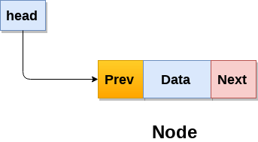
Doubly Linked List
Double linked list is a sequence of elements in which every element has links to its previous element and next element in the sequence.
So, we can traverse forward by using the next field and can traverse backward by using the previous field.
Every node in a double linked list contains three fields and they are shown in the following figure...

Slide 6
Two-Way List
A two-way list is a linear collection of data element called nodes where each node N is divided into three parts:
An information field INFO which contains the data of N
A pointer field ‘NEXT_link’ which contains the location of the next node in the list
A pointer field ‘PREVIOUS_link’ which contains the location of the preceding node in the list

Slide 7
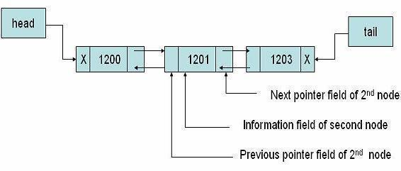
Two-Way List
List requires two pointer variables:
HEAD: which points to the first node in the list
TAIL: which points to the last node in the list

Slide 8
Difference
single linked list
every node has a link to its next node in the sequence.
we can traverse from one node to another node only in one direction we can not traverse back
double linked list
every node has a link to its previous node and next node.
So, we can traverse forward by using the next field and can traverse backward by using the previous field

Slide 9
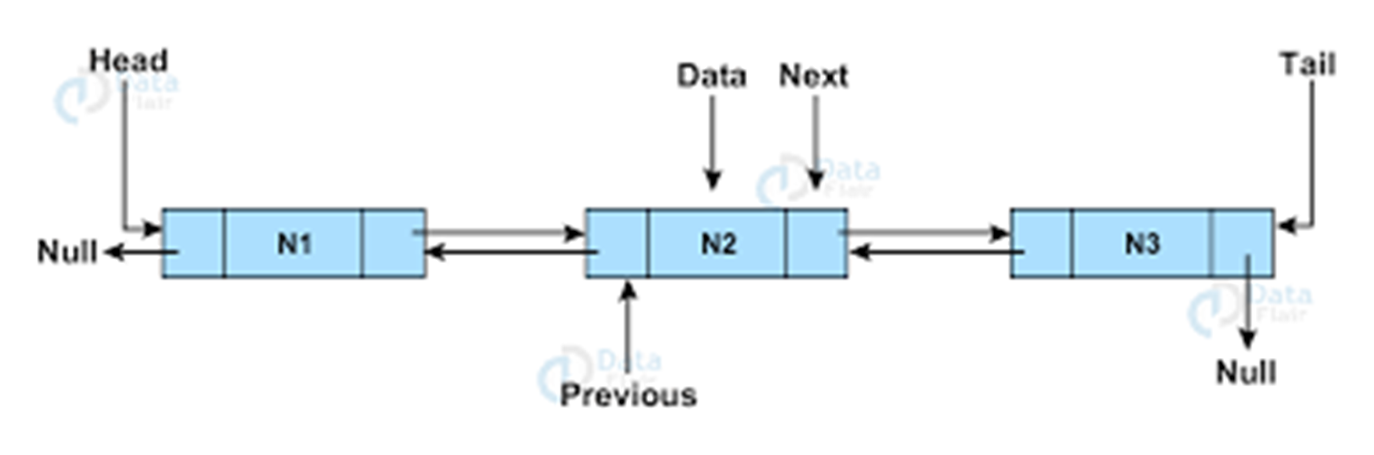
Important Points to be remember
In double linked list, the first node must be always pointed by head.
Always the previous field of the first node must be NULL.
Always the next field of the last node must be NULL.

Slide 10
Applications/Uses of doubly linked list in real life
Doubly linked list can be used in navigation systems where both front and back navigation is required.
It is used by browsers to implement backward and forward navigation of visited web pages i.e. back and forward button.
It is also used by various application to implement Undo and Redo functionality.
It can also be used to represent deck of cards in games. It is also used to represent various states of a game.

Slide 11
Doubly Linked List Declaration
struct node
{
int data;
struct node *prev;
struct node *next;
}*head, *tail;

Slide 12
Operation in two-way list
Traversing
Searching
Deletion
Insertion
Display

Slide 13
Operation in two-way list
At Beginning of the list
At End of the list
At Specific location in the list
Insertion
●

Slide 14
Operation in two-way list
At Beginning of the list
At End of the list
Deletion
At Specific location in the list

Slide 15
Operation in two-way list
Forward list
Display
Reverse list

Slide 16
Traversing in two-way list
struct node *p
if (start== Null), then print underflow & return.
p=start; //forward traversing
while(p!=null)
{
print p->info;
p= p ->next;
}
p=last; //backward traversing
while(p!=null)
{
print p->info;
p= p ->prev;
}

Slide 17
Forward Search in Two-way List
Step1: If Start = Null Then
Print:”Linked List is Empty”
Exit
[End If]
Step 2: Set Ptr= Start // forward searching
Step 3: Repeat While Ptr ! = Null
If Ptr → info = Data Then
Print : “Element is found at address”:Ptr Exit
Else
Set Ptr = Ptr →Next
[End If]
[End Loop]
Step 4: Print : “Element not found in linked list” Step 5 :Exit

Slide 18
Backward Searching in Two-way List
Step1: If Start = Null Then
Print:”Linked List is Empty”
Exit
[End If]
Step 2: Set Ptr= last // backward searching
Step 3: Repeat While Ptr ! = Null
If Ptr → info = Data Then
Print : “Element is found at address”:Ptr Exit
Else
Set Ptr = Ptr →Prev
[End If]
[End Loop]
Step 4: Print : “Element not found in linked list” Step 5 :Exit

Slide 19
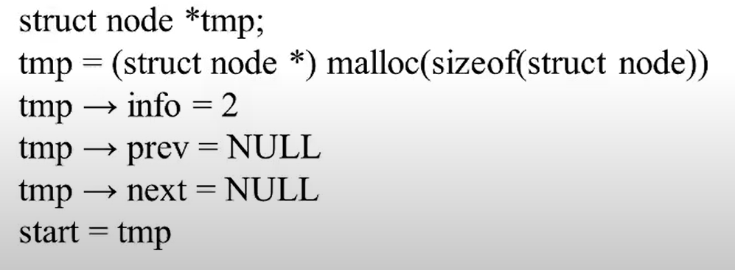
Algorithm for insertion in two-way list- At Start when start is null
if (start == Null)

Slide 20
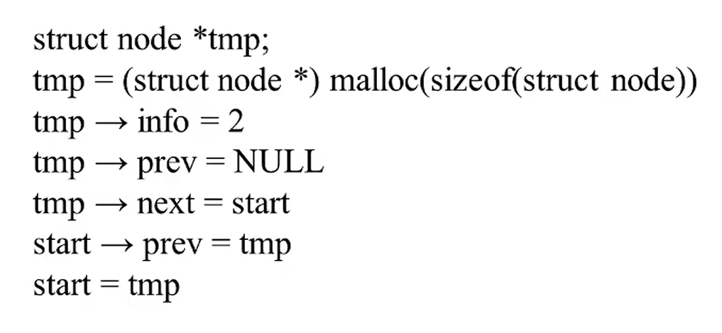
Algorithm for insertion in two-way list At Start when start is not null

Slide 21
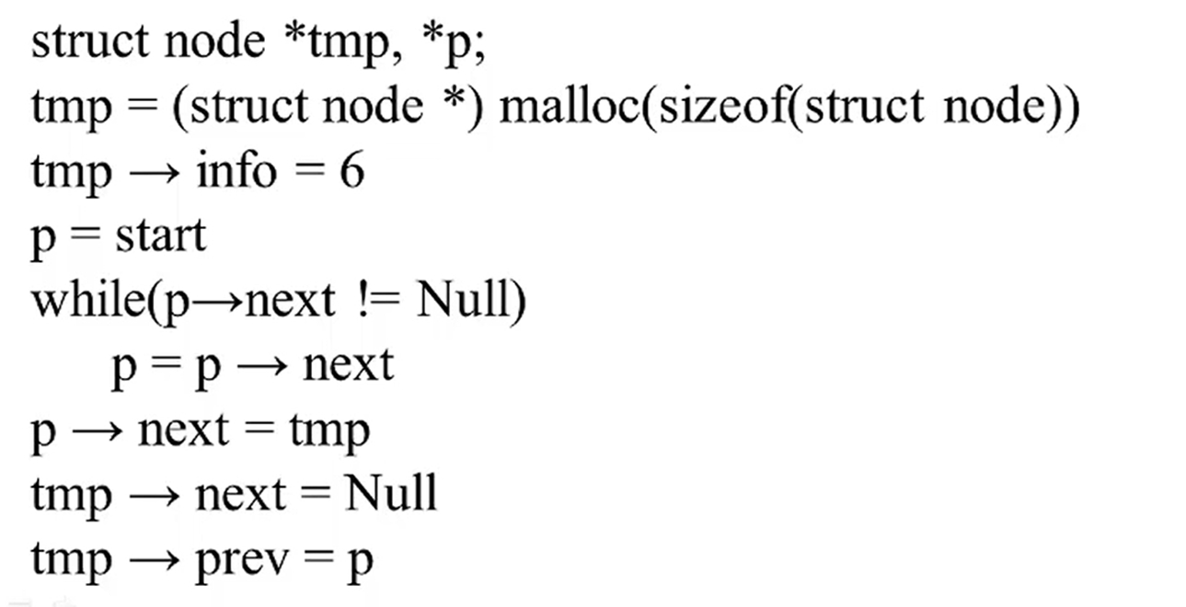
Algorithm for insertion in two-way list At End

Slide 22
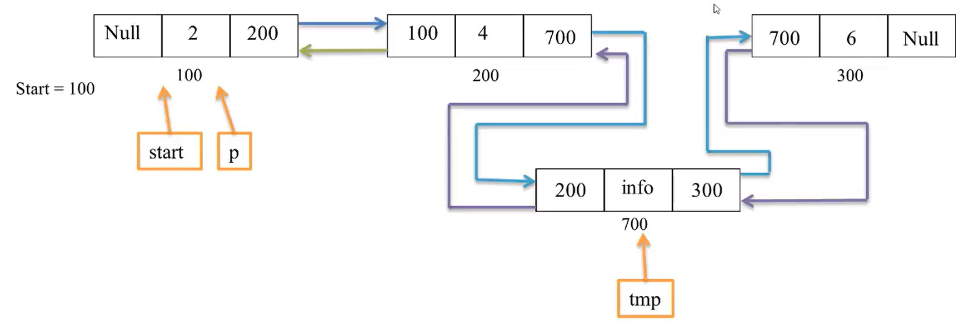
Algorithm for insertion in two-way list At any Position

Slide 23
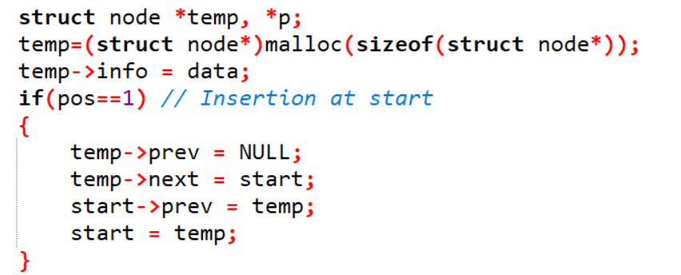
Algorithm for insertion in two-way list At any Position

Slide 24
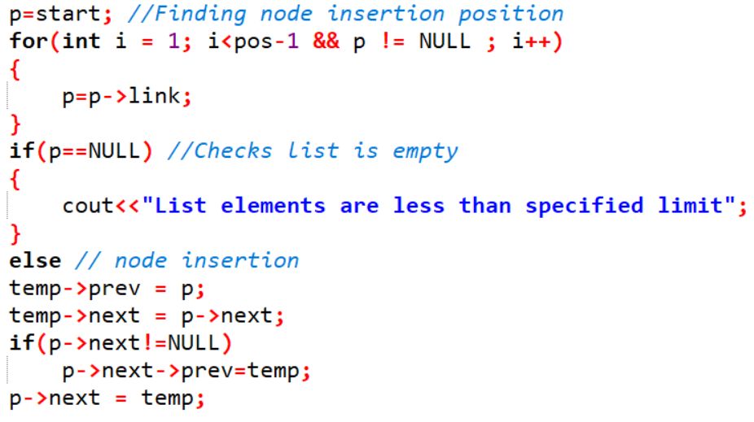
Algorithm for insertion in two-way list At any Position

Slide 25
Questions?

